Slide 1
GREEN CITY ,GREEN INDIA
Team Name – Go Green City
Team Member -
Daksh Joshi
Aman Jain
Shubham Joshi
Type Of Project :
Coding – (html , CSS)
PowerPoint Presentation

Slide 2
PROBLEM STATEMENT
People is not enough aware about environmental Acts and regulations.
There are many problems or environmental related issues which is not reached to the Government due to any specific reason.
There are many threat related issues related to the Environment.

Slide 3
PROBLEM SOLUTION
There are many people who do not think about Environment Conservation since some of them are unaware about it.
The lack of attention towards environment is a major cause of concern because rapidly growing world population and the increased use of energy are placing unprecedented pressures on earth and hence our environment
We have make a website which will provide them all the threats related issues to the people with all the solution.
We will provide him all the solution through this website.
Lets analysis the website through this presentation :-

Slide 4
The Earth is getting affected by this environmental threats like global warming , deforestation leads to pollution which create hole in ozone so indirectly it is human who is getting affected.
We are working on this idea for last months because we want that people should get knowledge about the environmental threats and their precaution.

Slide 5
Something About Website
Everything starts with some name so name of our website is : “Green City , Green India”
Our site contain four main blocks :
1. Swachh Bharat
2. NGO List
3.Youth Involvement
4.Goverment’s Project
5.Contact
Some Of them contain subparts.
We have also provided videos in our site so that user will understand things easily and get the future details also.

Slide 6
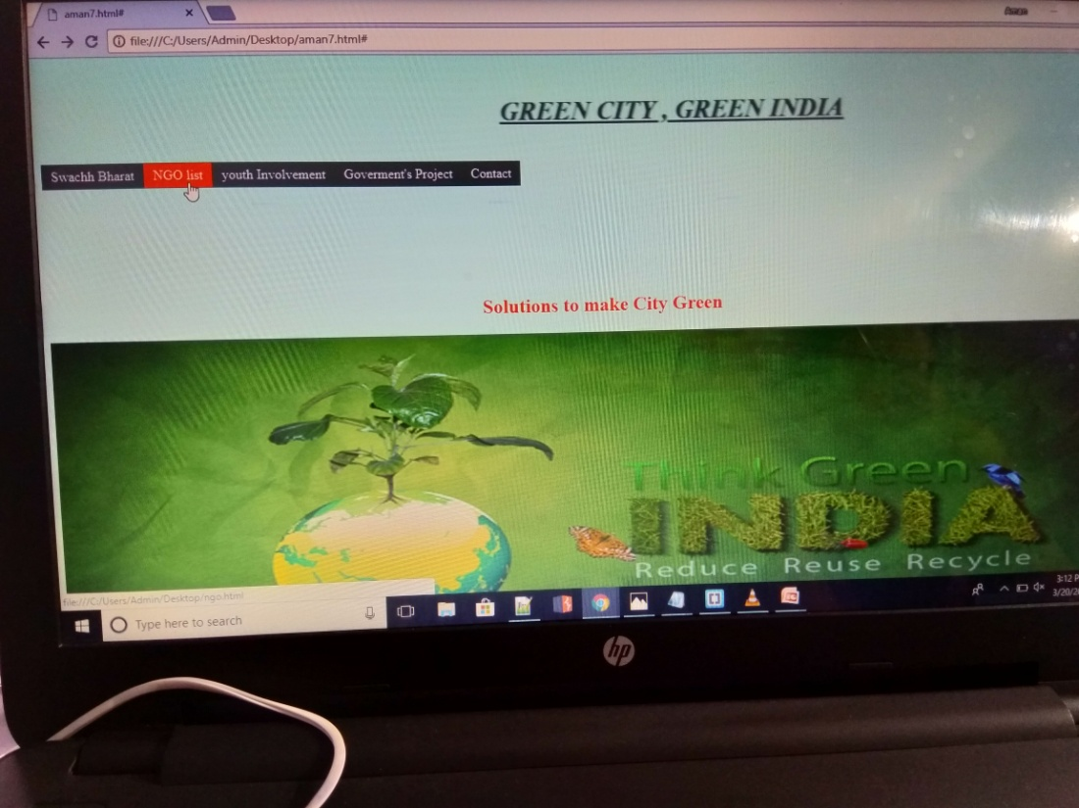
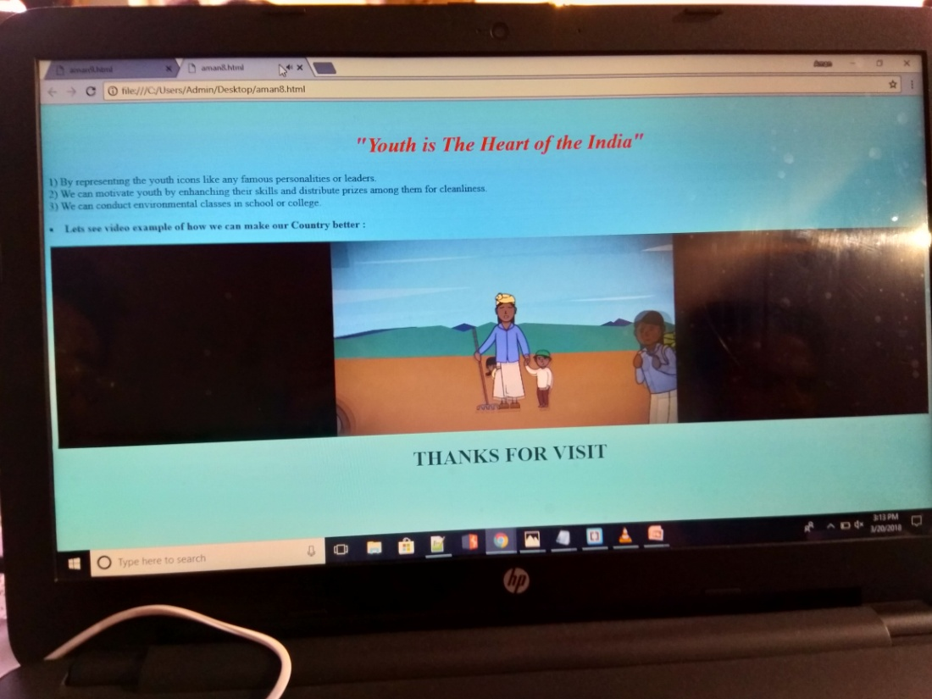
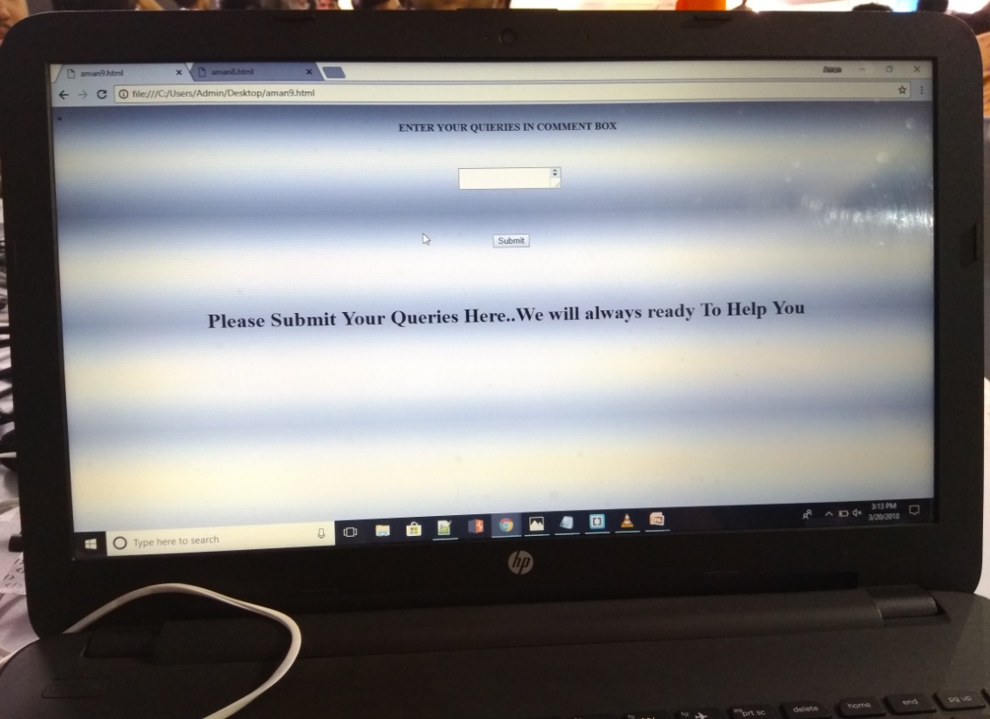
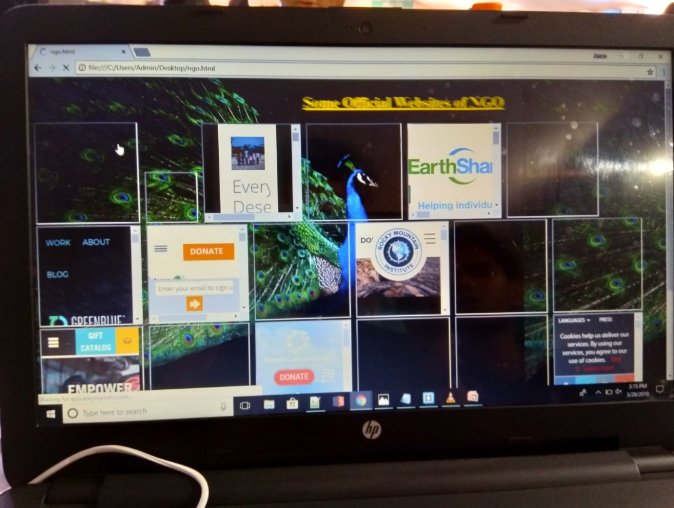

Slide 7
What is Green City ,Green India..?
Cities focused on sustainability, the emerging “Green Cities movement" encompasses thousands of urban areas around the world all striving to lessen their environmental impacts by reducing waste, expanding recycling, lowering emissions, increasing housing density while expanding open space, and encouraging the development of sustainable local businesses.
It simply a small steps toward making our city and Nation agreen ,clean and Developed .
The Green City aims to inform and stimulate the interest with authorities, organizations and companies which are professionally involved in planning and developing the urban area, ensuring green will be applied appropriately.
If our city will be clean and clean there is less chances of disease and people will stay healthy.
So we have make a small website where we make website to create awareness among people.

Slide 8
Swachh Bharat Abhiyan
Swachh Bharat Abhiyan (Hindi:स्वच्छ भारत अभियान, English: Clean India Mission) is a national campaign by the Government of india,covering 4041 statutory towns, to clean the streets, roads and infrastructure of the country.
This campaign was officially launched on 2 October 2014 at Rajghat, New Delhi, where Prime Minister Narendra Modi himself cleaned the road. It is India's biggest ever cleanliness drive and 3 million government employees and school and college students of India participated in this event. The mission was started by Prime Minister Modi, who nominated nine famous personalities for the campaign, and they took up the challenge and nominated nine more people and so on (like the branching of a tree). It has been carried forward since then with people from all walks of life joining it.

Slide 9
Role Of NGO in Environment
Environmental NGOs can play a crucial role in helping to plug gaps by conducting research to facilitate policy development, building institutional capacity, and facilitating independent dialogue with civil society to help people live more sustainable lifestyles.
NGOs are not only stakeholders in governance, but also a driving force behind greater international cooperation through the active mobilization of public support for international agreements.
There are many NGO’s which is present for the help for environmental protection so we have connected all the NGO’s through our websites so that people will easily get the NGO app. Like :
1. World Wide Fund (WWF-India)
2.EarhShare

Slide 10
YOUTH INVOLVEMENT
Youth are back bone of the nation. They can change the future of the society with their well being and courageous behaviour.
There are also many collection points for recycling of rechargeable batteries, so do not simply throw them away. Youth have a role to play in environmental and conservation efforts that will improve livelihoods.
It is high time for youth to analyse their needs and decide what are their true priorities are. We have plenty of resources. But the demand is increasing day by day. It is the responsibility of the youth to manage it efficiently.
Youth is getting distracted so we have provided all the videos and content for the their motivation.

Slide 11
GOVERNMENT’S PROJECT
We have included many government projects and Environmental acts so that prople get aware about that.
We have linked this acts and projects through our website so that it easily available.
Some of the acts are :
@ Wildlife Protection Act 1972
@Forest Act 1980
@Water Act 1971
We have also linked official website og ministry of Environmental forest and climate into our website.
Latest project “GREEN INDIA” , ia also available on our site.

Slide 12
CONTACT
Our app also includes Contact blog so that if anyone have queries then they will easily contact to NGO and us.
We have also provide with the query box so that user seems easy to use the website.
We have also provided comment section to give ideas and views about the relevant projects and ideas.

Slide 13
OUTCOMES
By this website people can know about every environmental programs and act.They will get all the information at one place only.
Youth get motivated by this and may be will get concerned about environment,
Less cause of disease, aforestation, plantation and developed everywhere.
This will lead to decrease in global warming and other hazardous effect.

Slide 14
FUTURE ASPECTS
This website will always be update whenever new environmental projects or acts will come.
Uniformly updation of videos and audios on website regarding to environment.
Banners and posters will also been post on this website.

Slide 15
THANK YOU

